Slide 1
An Analysis of Nutrition Programs and Policies in Tajikistan
Alona Guseva

Slide 2
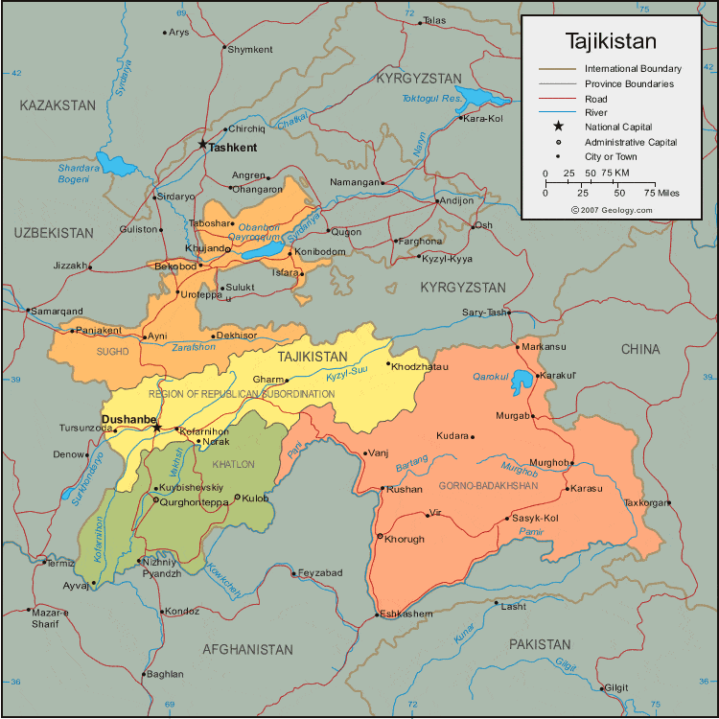
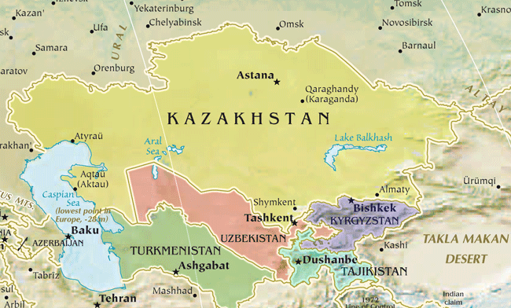
Tajikistan
Above: http://www.frontiersoftravel.com/maps/central_asia.gif
At left: http://geology.com/world/tajikistan-map.gif

Slide 3
Overnutrition among women (15-49)
More common among:
Older women (>30)
Wealthier women
Urban women

Slide 4
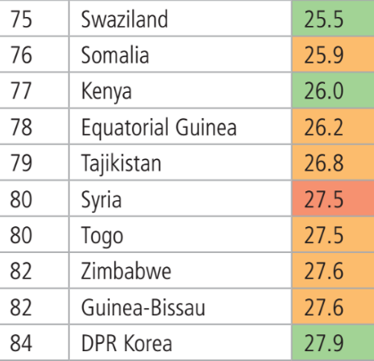
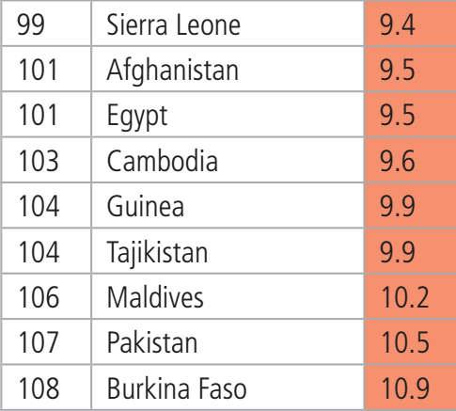
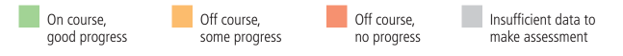
Undernutrition among children (<5)
35% child mortality attributed to undernutrition
Stunting: 26.8%
Wasting: 9.9%
Source: Global Nutrition Report, 2016

Slide 5
Micronutrient deficiency
Anemia
Associated with weakness, fatigue, poor appetite, slowed growth
Women: 25%
Children: 30%
Iodine deficiency
Associated with miscarriage, stunted physical and mental development
Women: 60%
Children: 53%

Slide 6
Immediate causes
Inappropriate dietary intake
Disease

Slide 7
Underlying causes
Household food insecurity
Only 16% rural population is food secure
Inappropriate care and feeding practices
Infant and young child feeding
Lack of diversity in diet
Unhealthy household environment and inadequate health services

Slide 8
Basic causes
Household poverty
47% living on less than US$1.33 a day
Contextual factors
Natural resource constraints
Dependence on remittances
Economic transition and civil war in 1990s

Slide 9
Maintain status quo
+
Funded and administered by non-governmental entities
Address multiple forms and causes of malnutrition
-
Insufficient progress
Short timeframe of operations
Limited geographic reach

Slide 10
Food subsidization
+
Immediate relief to the food insecure
-
Increases only food access without addressing availability problem
Temporary alleviation of symptoms, rather than long-term solution

Slide 11
Supplementary feeding
+
Immediate and direct relief for the undernourished
National school meals program already in development
-
Relief is temporary and only applicable for undernutrition

Slide 12
Micronutrient supplementation
+
Simple and cost-effective way to medically treat deficiencies
-
Difficult to ensure compliance among participants
Addresses only insufficient intake and not its causes

Slide 13
Iodized salt quality assurance
+
Salt iodization is mandated by law
Existing standards and framework for regulation
Existing demand
-
Previous difficulties with implementation

Slide 14
Wheat flour fortification
+
Food-based approach to treating micronutrient deficiencies
-
Difficulty of regulation and quality control
May be unaffordable for target consumers

Slide 15
Nutrition education for women
+
Can help reduce all forms of malnutrition
Intergenerational effect of female education
Encourages behavior change
-
Changes demand without addressing supply problem

Slide 16
Household farming
+
Already a widespread practice
Can improve both quantity and quality of intake
Addresses both food availability and access
Sustainable solution
-
More effective with agrarian reform
Natural resource constraints limit reach

Slide 17
Recommendations
 | Technical Feasibility | Administrative Operability | Financial Viability | Political Viability | Sustainability
Maintain status quo | Low | High | High | Low | Low
Food subsidization | Medium | Low | Low | High | Low
Supplementary feeding | Medium | High | Medium | High | Low
Micronutrient supplementation | Medium | Low | Low | Medium | Low
Iodized salt quality assurance | Medium | Medium | Medium | High | Medium
Wheat flour fortification | Medium | Low | Low | Low | Medium
Nutrition education for women | N/A | Low | Low | Medium | High
Household farming | Medium | Low | Low | High | High

Slide 18
Recommendations
 | Technical Feasibility | Administrative Operability | Financial Viability | Political Viability | Sustainability
Maintain status quo | Low | High | High | Low | Low
Food subsidization | Medium | Low | Low | High | Low
Supplementary feeding | Medium | High | Medium | High | Low
Micronutrient supplementation | Medium | Low | Low | Medium | Low
Iodized salt quality assurance | Medium | Medium | Medium | High | Medium
Wheat flour fortification | Medium | Low | Low | Low | Medium
Nutrition education for women | N/A | Low | Low | Medium | High
Household farming | Medium | Low | Low | High | High

Slide 19
Thank you
Questions?

